Slide 1



Dictionaries, Lambda and LINQ
Collections and Queries
Dictionaries
Lambda
LINQ
SoftUni Team
Technical Trainers
Software University
http://softuni.bg

Slide 2

Table of Contents
Dictionaries and Dictionary<K, V>
Mapping Keys to Values
Data Processing with Lambda and LINQ
Filtering, Mapping, Ordering

Slide 3
Questions?
sli.do #Tech

Slide 4
Associative Arrays
ivan
gosho
pesho
0845-346-356
2350-452-167
1255-377-131
Dictionary<Key, Value>

Slide 5
Associative Arrays (Maps, Dictionaries)
Associative arrays are arrays indexed by keys
Not by the numbers 0, 1, 2, …
Hold a set of pairs {key → value}
Traditional array
Associative array
key
value
key
0 1 2 3 4
John Smith | +1-555-8976
Lisa Smith | +1-555-1234
Sam Doe | +1-555-5030
value
8 | -3 | 12 | 408 | 33

Slide 6
Dictionary<K, V>, SortedDictionary<K, V>
Have property Count – the number of key-value pairs
Keys – a set of unique keys
Values – a collection of all values
Basic operations – Add(), Remove(), Clear()
Dictionary<string, int> dict = new Dictionary<string, int>();
foreach(var key in dict.Keys)
Console.WriteLine(key);
foreach(var value in dict.Values)
Console.WriteLine(value);

Slide 7
Dictionary<K, V>, SortedDictionary<K, V>(2)
Boolean methods:
ContainsKey() – checks if a key is present in the dictionary
ContainsValue() – checks if a value is present in the dictionary
TryGetValue() – check if a key is present in the dictionary and ouputs the value, or returns the default value of the type.

Slide 8
Dictionary<K, V> – Add()
Dictionary<string, string>
Pesho
0881-123-987
Gosho
0881-123-789
Alice
0881-123-978
Hash Function
Key Value

Slide 9
Dictionary<K, V> – Remove()
Dictionary<string, string>
Pesho
Pesho
0881-123-987
Gosho
0881-123-789
Hash Function
Alice
0881-123-978
Key Value

Slide 10
Looping through dictionaries
For Each
KeyValuePair<string, string> keyValuePair in
Dictionary<string, string>
Pesho
Pesho
0881-123-987
0881-123-987
Gosho
Gosho
0881-456-987
0881-456-987
Alice
+359-899-55-592
Alice
+359-899-55-592
.Key .Value
Notes:
foreach (KeyValuePair<string, int> keyValuePair in phonebook)
{
Console.WriteLine("name: {0}, mobile number: {1}",
keyValuePair.Key,
keyValuePair.Value);
}

Slide 11
Phonebook – Dictionary Example
var phonebook = new Dictionary<string, string>();
phonebook["John Smith"] = "+1-555-8976"; phonebook["Lisa Smith"] = "+1-555-1234";
phonebook["Sam Doe"] = "+1-555-5030";
phonebook["Nakov"] = "+359-899-555-592";
phonebook["Nakov"] = "+359-2-981-9819";
phonebook.Remove("John Smith");
foreach (KeyValuePair<string, string> pair in phonebook)
{
Console.WriteLine("{0} --> {1}", pair.Key, pair.Value);
}

Slide 12
Problem: Odd Occurrences
Write a program to extract from given sequence of words all elements that present in it odd number of times (case-insensitive)
Words are given in a single line, space separated
Print the result elements in lowercase, in their order of appearance
Java C# PHP PHP JAVA C java
java, c#, c
3 5 5 hi pi HO Hi 5 ho 3 hi pi
5, hi
a a A SQL xx a xx a A a XX c
a, SQL, xx, c
Check your solution here: https://judge.softuni.bg/Contests/Practice/Index/174#1

Slide 13
Solution: Odd Occurrences
string input = Console.ReadLine().ToLower();
string[] words = input.Split(' ');
var counts = new Dictionary<string, int>();
foreach (var word in words)
if (counts.ContainsKey(word))
counts[word]++;
else counts[word] = 1;
var results = new List<string>();
foreach (var pair in counts)
// TODO: add pair.Key to results if pair.Value is odd
Console.WriteLine(string.Join(", ", results));
counts[word] holds how many times word occurs in words
Check your solution here: https://judge.softuni.bg/Contests/Practice/Index/174#1

Slide 14
SortedDictionary<K, V> – Example
SortedDictionary
<string, string>
Alice
+359-899-55-592
Pesho
0881-123-987
Key Value

Slide 15
Events – SortedDictionary Example
var events = new SortedDictionary<DateTime, string>();
events[new DateTime(1998, 9, 4)] = "Google's birth date";
events[new DateTime(2013, 11, 5)] = "SoftUni's birth date";
events[new DateTime(1975, 4, 4)] = "Microsoft's birth date";
events[new DateTime(2004, 2, 4)] = "Facebook's birth date";
events[new DateTime(2013, 11, 5)] = "SoftUni was founded";
foreach (var entry in events)
{
Console.WriteLine("{0:dd-MMM-yyyy}: {1}",
entry.Key, entry.Value);
}

Slide 16
Problem: Count Real Numbers
Read a list of real numbers and print them in ascending order along with their number of occurrences
8 2.5 2.5 8 2.5
1.5 5 1.5 3
-2 0.33 0.33 2
2.5 -> 3 times
8 -> 2 times
1.5 -> 2 times
3 -> 1 times
5 -> 1 times
-2 -> 1 times
0.33 -> 2 times
2 -> 1 times
Check your solution here: https://judge.softuni.bg/Contests/Practice/Index/174#0

Slide 17
Solution: Count Real Numbers
string[] nums = Console.ReadLine().Split(' ');
var counts = new SortedDictionary<double, int>();
foreach (var num in nums)
double parsedNum = double.Parse(num);
if (counts.ContainsKey(parsedNum))
counts[parsedNum]++;
else
counts[parsedNum] = 1;
foreach (var num in counts.Keys)
Console.WriteLine($"{num} -> {counts[num]}");
counts[num] holds how many times num occurs in nums
Check your solution here: https://judge.softuni.bg/Contests/Practice/Index/174#0

Slide 18

Associative Arrays
Exercises in class

Slide 19
Lambda Functions and LINQ
LINQ
LINQ in Action: Filtering, Mapping, Ordering

Slide 20
Math Operations
Min() – Finds the smallest element in a collection
Max() – Finds the largest element in a collection
Sum() – Finds the sum of all elements in a collection
Average() – Finds the average of all elements in a collection
{1, 2, 3, 4, -1, -5, 0, 50} => -5
{1, 2, 3, 4, -1, -5, 0, 50} => 50
{1, 2, 3, 4, -1, -5, 0, 50} => 54
{1, 2, 3, 4, -1, -5, 0, 50} => 6.75

Slide 21
Problem: Sum, Min, Max, Average
Write a program to read n integers and print their sum, min, max and average values:
5
12
20
-5
37
8
Sum = 72
Min = -5
Max = 37
Average = 14.4
4
50
20
25
40
Sum = 135
Min = 20
Max = 50
Average = 33.75
Check your solution here: https://judge.softuni.bg/Contests/Practice/Index/174#2

Slide 22
Solution: Sum, Min, Max, Average
Use System.Linq to enable LINQ functions like .Max() and .Sum()
using System.Linq;
…
int n = int.Parse(Console.ReadLine());
int[] nums = new int[n];
for (int i = 0; i < n; i++)
nums[i] = int.Parse(Console.ReadLine());
Console.WriteLine("Sum = {0}", nums.Sum());
Console.WriteLine("Min = {0}", nums.Min());
// TODO: print also max and average values
Check your solution here: https://judge.softuni.bg/Contests/Practice/Index/174#2

Slide 23
Reading Collections on a Single Line
Using Select() to read collections:
var nums = Console.ReadLine()
.Split()
.Select(number => double.Parse(number));
// .Select(double.Parse);
var nums = Console.ReadLine()
.Split()
.Select(int.Parse);
// .Select(number => int.Parse(number));

Slide 24
Converting Collections
Using ToArray(), ToList() to convert collections:
There is also a ToDictionary() and ToCharArray() methods that we will see in the next slides
int[] nums = Console.ReadLine()
.Split()
.Select(number => int.Parse(number))
.ToArray();
List<double> nums = Console.ReadLine()
.Split()
.Select(double.Parse)
.ToList();

Slide 25
Sorting Collections
Using OrderBy() to sort collections:
Using OrderByDescending() to sort collections:
List<int> nums = { 1, 5, 2, 4, 3 };
nums = nums
.OrderBy(num => num)
.ToList()
List<int> nums = { 1, 5, 2, 4, 3 };
nums = nums
.OrderByDescending(num => num)
.ToList()

Slide 26
Sorting Collections(2)
Using ThenBy() to sort collections by more than 1 criteria:
Similar to OrderByDescending(), there is also ThenByDescending()
Dictionary<int, string> products =
new Dictionary<int, string>();
Dictionary<int, string> sortedDict = products
.OrderBy(pair => pair.Value)
.ThenBy(pair => pair.Key)
.ToDictionary(pair => pair.Key,
pair => pair.Value);

Slide 27
Take/Skip N Elements from Collection
Using Take(), Skip():
int[] nums = { 1, 2, 3, 4, 5, 6};
nums = nums
.Take(3)
.ToArray();
// nums = [1, 2, 3]
int[] nums = { 1, 2, 3, 4, 5, 6};
nums = nums
.Skip(3)
.ToArray();
// nums = [4, 5, 6]

Slide 28
Problem: Largest 3 Numbers
Read a list of real numbers and print largest 3 of them
10 30 15 20 50 5
50 30 20
20 30
30 20
0 -5 -1 -3 -2
0 -1 -2
Check your solution here: https://judge.softuni.bg/Contests/Practice/Index/174#3

Slide 29
Solution: Largest 3 Numbers
string[] strings = Console.ReadLine().Split(' ');
List<int> nums = strings
.Select(int.Parse)
.ToList();
var sortedNums = nums.OrderByDescending(x => x);
var largest3Nums = sortedNums.Take(3);
Console.WriteLine(string.Join(" ", largest3Nums));
Check your solution here: https://judge.softuni.bg/Contests/Practice/Index/174#3

Slide 30
Lambda Expressions
A lambda expression is an anonymous function containing expressions and statements
Lambda expressions
Use the lambda operator =>
Read as "goes to"
The left side specifies the input parameters
The right side holds the expression or statement

Slide 31
Lambda Functions
Lambda functions are inline methods (functions) that take input parameters and return values:
x => x / 2
static int Func(int x) { return x / 2; }
x => x != 0
static bool Func(int x) { return x != 0; }
() => 42
static int Func() { return 42; }

Slide 32
Filter Collections
Using Where(), Count():
int[] nums = { 1, 2, 3, 4, 5, 6};
nums = nums
.Where(num => num % 2 == 0)
.ToArray();
// nums = [2, 4, 6]
int[] nums = { 1, 2, 3, 4, 5, 6};
int count = nums.Count(num => num % 2 == 0);
// count = 3

Slide 33
Filtering and Sorting with Lambda Functions
int[] nums = { 11, 99, 33, 55, 77, 44, 66, 22, 88 };
nums.OrderBy(x => x).Take(3);
// 11 22 33
nums.Where(x => x < 50);
// 11 33 44 22
nums.Count(x => x % 2 == 1);
// 5
nums.Select(x => x * 2).Take(5);
// 22 198 66 110 154

Slide 34
Getting Unique Elements from Collection
Using Distinct():
int[] nums = { 1, 2, 2, 3, 4, 5, 6, -2, 2, 0, 15, 3, 1, 0, 6};
nums = nums
.Distinct()
.ToArray();
// nums = [1, 2, 3, 4, 5, 6, -2, 0, 15]

Slide 35
Problem: Short Words Sorted
Read a text, extract its words, find all short words (less than 5 characters) and print them alphabetically, in lower case
Use the following separators: . , : ; ( ) [ ] " ' / \ ! ? (space)
Use case-insensitive matching; remove duplicated words
In SoftUni you can study Java, C#, PHP and JavaScript. JAVA and c# developers graduate in 2-3 years. Go in!
2-3, and, c#, can, go, in, java, php, you
Check your solution here: https://judge.softuni.bg/Contests/Practice/Index/174#4

Slide 36
Solution: Short Words Sorted
char[] separators = new char[]
{'.',',',':',';','(',')','[',']','\\','\"','\'','/','!','?',' '};
string sentence = Console.ReadLine().ToLower();
string[] words = sentence.Split(separators);
var result = words
.Where(w => w != "")
// TODO: filter by word length < 5
.OrderBy(w => w).Distinct();
Console.WriteLine(string.Join(", ", result));
Check your solution here: https://judge.softuni.bg/Contests/Practice/Index/174#4

Slide 37
Take Single Element from Collection
Using First(), Last() , Single():
int[] nums = { 1, 2, 3, 4, 5, 6};
int num = nums.First(x => x % 2 == 0);
// num = 2
int[] nums = { 1, 2, 3, 4, 5, 6};
int num = nums.Last(x => x % 2 == 1);
// num = 5
int[] nums = { 1, 2, 3, 4, 5, 6};
int num = nums.Single(x => x == 4);
// num = 4

Slide 38
Other Operations over Collections
Using Reverse()
Using Concat():
int[] nums = { 1, 2, 3, 4, 5, 6};
nums = nums.Reverse();
// nums = 6, 5, 4, 3, 2, 1
int[] nums = { 1, 2, 3, 4, 5, 6 };
int[] otherNums = { 7, 8, 9, 0 };
nums = nums.Concat(otherNums);
// nums = 1, 2, 3, 4, 5, 6, 7, 8, 9, 0

Slide 39
Problem: Fold and Sum
Read an array of 4*k integers, fold it like shown below, and print the sum of the upper and lower rows (2*k integers):
1 2
3 4 5 6
7 8
5 2 3 6
5 6
2 3
7 9
1 2
7 8
1 2 3 4 5 6 7 8
2 1 8 7
3 4 5 6
5 5 13 13
3 4 5 6
4 3 -1 2 5 0 1 9 8 6 7 -2
-1 3 4 -2 7 6
2 5 0 1 9 8
1 8 4 -1 16 14
Check your solution here: https://judge.softuni.bg/Contests/Practice/Index/174#5

Slide 40
Solution: Fold and Sum
int[] arr = Console.ReadLine()
.Split(' ').Select(int.Parse).ToArray();
int k = arr.Length / 4;
int[] row1left = arr.Take(k).Reverse().ToArray();
int[] row1right = arr.Reverse().Take(k).ToArray();
int[] row1 = row1left.Concat(row1right).ToArray();
int[] row2 = arr.Skip(k).Take(2 * k).ToArray();
var sumArr =
row1.Select((x, index) => x + row2[index]);
Console.WriteLine(string.Join(" ", sumArr));
Check your solution here: https://judge.softuni.bg/Contests/Practice/Index/174#5

Slide 41

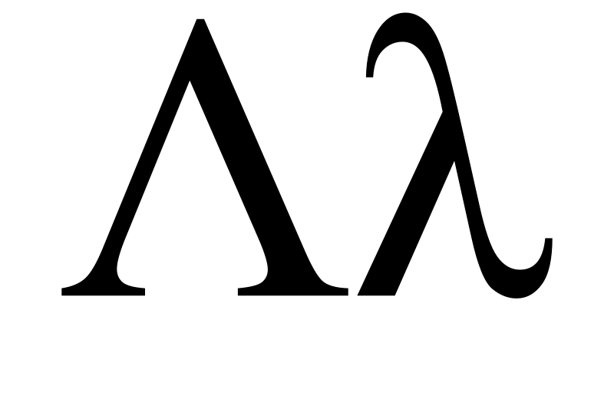
Lambda Expressions and LINQ
LINQ
var count = arr
.Where(e => e % 2 == 0)
.Count();
Live Exercises in Class (Lab)

Slide 42
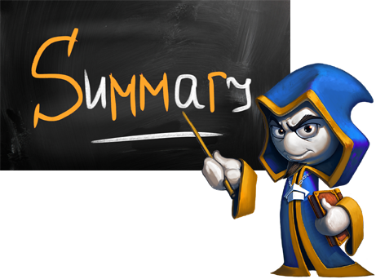
Summary
Dictionaries hold {key → value} pairs
.Keys holds a set of unique keys
.Values holds a collection of values
When you iterate over dictionary you use KeyValuePair<K, V>
Lambda and LINQ dramatically simplifies collection processing

Slide 43









Dictionaries, Lambda and LINQ
https://softuni.bg/courses/programming-fundamentals

Slide 44
License
This course (slides, examples, demos, videos, homework, etc.) is licensed under the "Creative Commons Attribution-NonCommercial-ShareAlike 4.0 International" license
Attribution: this work may contain portions from
"Fundamentals of Computer Programming with C#" book by Svetlin Nakov & Co. under CC-BY-SA license

Slide 45






Free Trainings @ Software University
Software University Foundation – softuni.org
Software University – High-Quality Education, Profession and Job for Software Developers
softuni.bg
Software University @ Facebook
facebook.com/SoftwareUniversity
Software University @ YouTube
youtube.com/SoftwareUniversity
Software University Forums – forum.softuni.bg

